Slide 1

ATOMS
Atomic Models of the Past
The Modern Atomic Model

Slide 2
Just How Small is An Atom?
http://www.schooltube.com/video/6e90652c7acd499ba85d/Just%20how%20small%20is%20an%20atom?
TED ED VIDEO

Slide 3
Atomic Ideas Through Time….

Slide 4
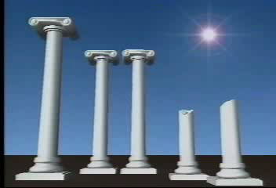
Ancient Ideas of the Atoms

Slide 5
Ancient Models
2000 years ago
Greek Scientist named Democritus stated that all matter was made of the smallest particle
Named the particle “atom” after the Greek word “atomos” meaning indivisible
Stated that different elements were various shapes

Slide 6
Daltons Theory
Early 1800’s
Dalton’s Theory had 4 parts:
1) All elements were made of atoms
2) Atoms of the same elements were alike
3) Atoms of different elements were different
4) Elements can be combined to form different substances

Slide 7
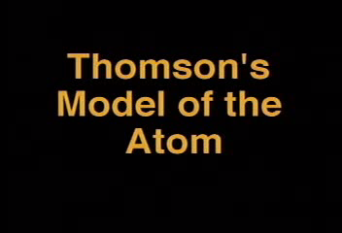
JJ Thomson

Slide 8
JJ Thomson
Late 1800’s
Found “Electrons”
Electrons are negatively charged particles in the atom
Electrons are responsible for electricity
Called the atom “plum pudding model” because he felt electrons were embedded in the atom

Slide 9
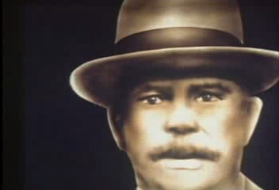
Rutherford’s Famous Experiment

Slide 10
Ernest Rutherford
1908
Found the nucleus of the atom
Used the famous “gold foil experiment”
Concluded that atoms were mostly made of empty space and that protons were located in the nucleus

Slide 11
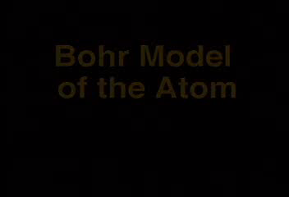
Bohr Model

Slide 12
More Atom Models Through Time
On pages 125 to 127, fill out the Atom Models Flowmap of the historical models of the atom.

Slide 13

The Modern Atomic Model

Slide 14
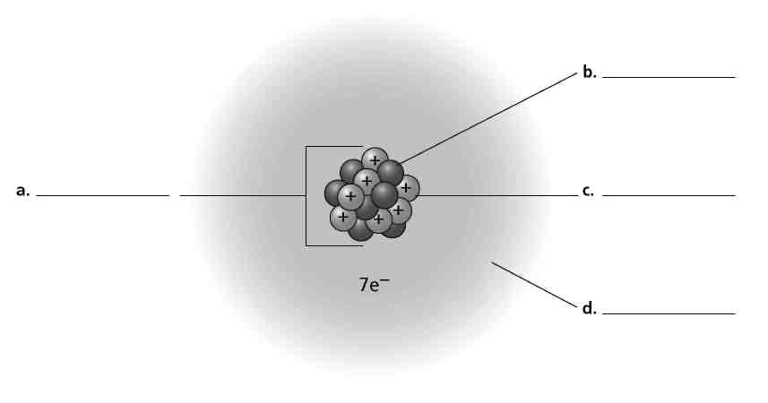
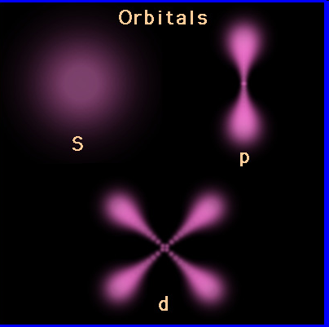
The Modern Atomic Model
Picture:
neutrons
nucleus
protons
electrons

Slide 15
Questions:
What are the 3 main subatomic particles?
The atom is mostly made of __________________________.
What is found in the center of an atom?
If protons are all positive, and like charges repel, why does the nucleus not fall apart?
Where are electrons found?
What are quarks?

