Slide 1
Warm up question
1. How do you think astronomers can see planets, stars, and galaxies that are so far away?

Slide 2
App Night Sky
Go to the app night sky. Try to locate the sun.
2. How do you think you are able to see the planets, stars, and sun from the classroom?
3. Are the stars in the sky during the day, or only at night?

Slide 3
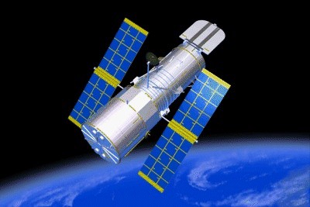
Reflecting Telescopes
A Reflecting telescope uses a curved mirror to collect and focus light. The larger the mirror and the more light it reflects the better the image. The largest optical telescopes today are all reflecting telescopes. Mirrors give a precise image.

Slide 4
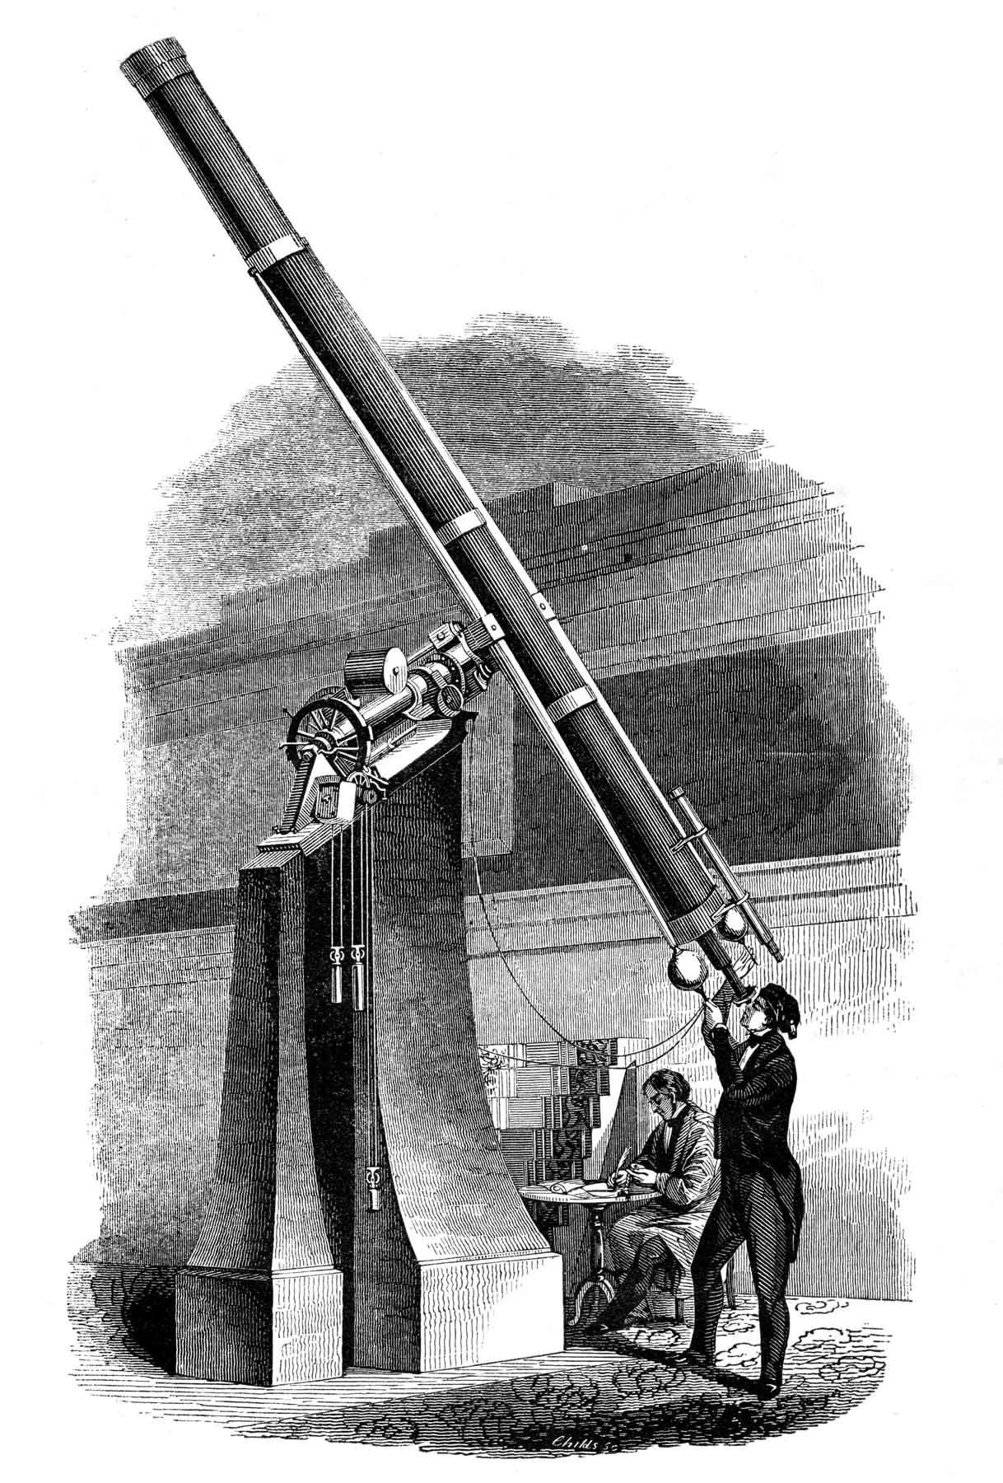
Refracting Telescopes
Refracting telescopes use a convex lens to gather and focus light. A convex lens is a piece of glass that is curved. This was one of the firsts types of telescopes designed and isn’t used that much today.

Slide 5
Think – Pair Share
4. What is the difference between Refracting and Reflecting Telescopes?
5. Which type is used today and why?

Slide 6
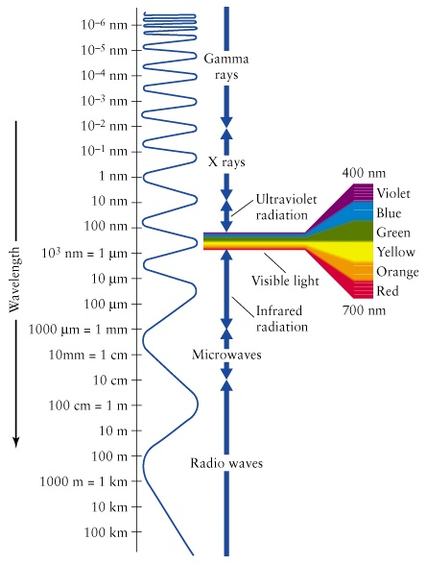
Different telescopes use different wavelengths to detect stars.

Slide 7
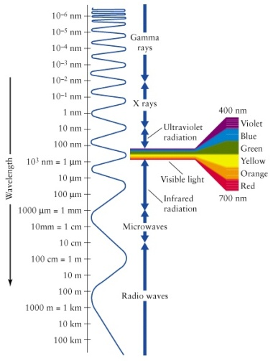
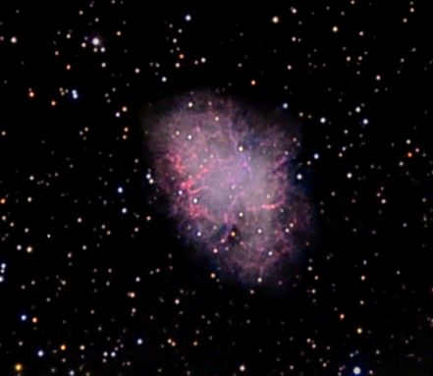
Radio Telescopes
A Radio
Telescope uses radio waves to detect objects in space. Most radio telescopes have curved surfaces up to 305 meters in diameter.
Picture of the crab nebula with a radio telescope.

Slide 8
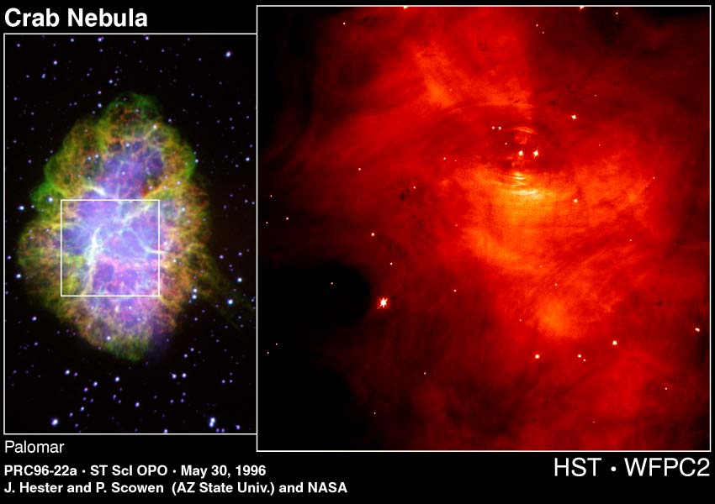

Other Telescopes
Optical and Infrared picture of the crab nebula
Infrared telescopes have longer wavelengths than visible light and shorter wavelengths than radio waves, the picture on the right is infrared. The Optical telescopes are reflecting telescopes and give images like the one on the left.

Slide 9
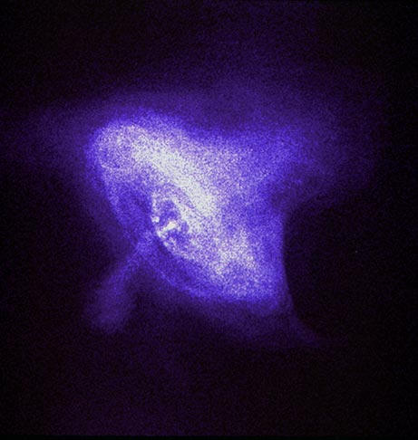

Other Telescopes
There are also telescopes that use UV radiation, X-ray , and gamma rays to detect objects in space. These telescopes gives the pictures more detail.
X-ray image of the crab nebula

Slide 10
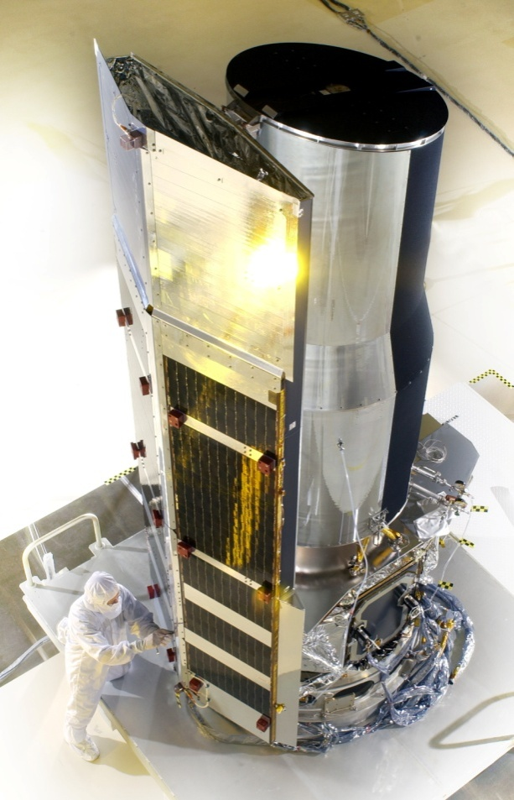
The Spitzer Space Telescopes
Telescopes placed in space allow astronomers to see objects with better detail because it is outside the atmosphere . The atmosphere has clouds, light, rain, and other weather conditions that interfere wit h the images. The Spitzer is in the infrared range of the spectrum.
Spitzer Telescope

Slide 11
Go to the app Idea sketch and turn to page 594 in your text.
6. Go to page 594 in your textbook and make a flow map listing the 6 main developments in the history of telescopes and two details about each.
7.When done go to mrs. Gonzales app. Click on Telescopes and answer the questions.

