Slide 1
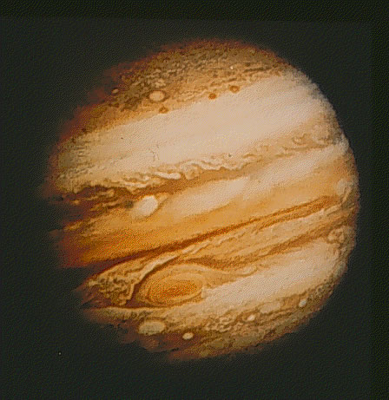
The Outer Planets - Jupiter
Jupiter, the largest of the planets, is 2.5 times more massive than all the other planets combined
It is covered by clouds made up of ammonia ice crystals.
Beneath the clouds the atmosphere continues for many thousands of kilometers
Jupiter’s Day is only 9.9 hrs.
A year on Jupiter is 11.9 Earth years

Slide 2
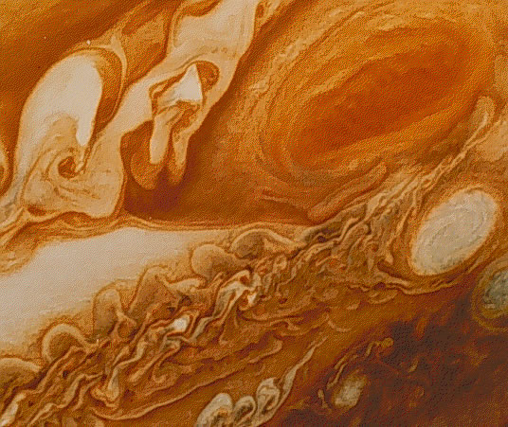
The Great Red Spot
The spot is an enormous storm (two Earths would fit inside it),
First observed over three centuries ago!
The clouds within the spot rotate with a period of about 6 days while the spot itself, along with the rest of the clouds, makes one rotation around Jupiter in a little under 10 hours.

Slide 3
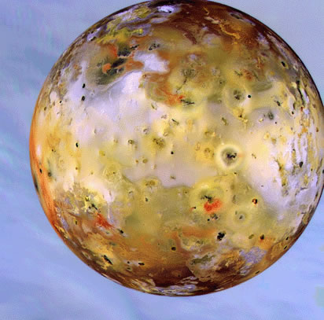
The Moons of Jupiter - Io
Roughly the size of Earth’s moon
In 1610 Galileo was the first to observe moons on other planets.
He found four moons orbiting Jupiter; Io, Europa, Ganymede, and Callisto
In 1979, the Voyager 1 spacecraft discovered nine active volcanos on Io
The volcanic activity results from competing gravitational pulls on Io exerted by Jupiter, and the other moons: Europa, and Ganymede.

Slide 4
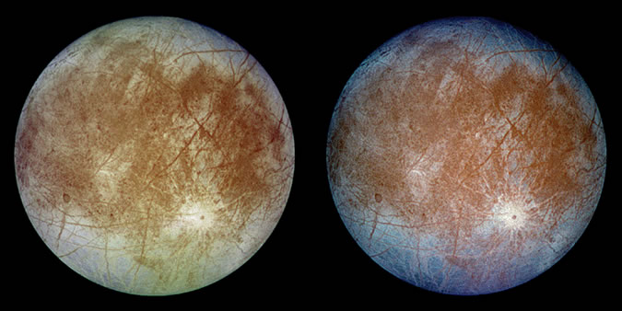
The Moons of Jupiter - Europa
The surface is water-ice making this a location scientists would like to explore for possible signs of life
The brown regions near the center of the images may include rock and mud mixed with the ice.

Slide 5
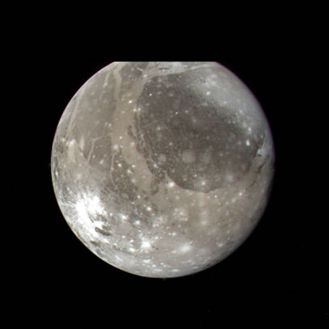
The Moons of Jupiter - Ganymede
The largest moon in the solar system – approx. 1.5 times large than Earth’s moon.
Ganymede is larger than the planet Mercury
The solid crust is thought to be very ice-rich

Slide 6
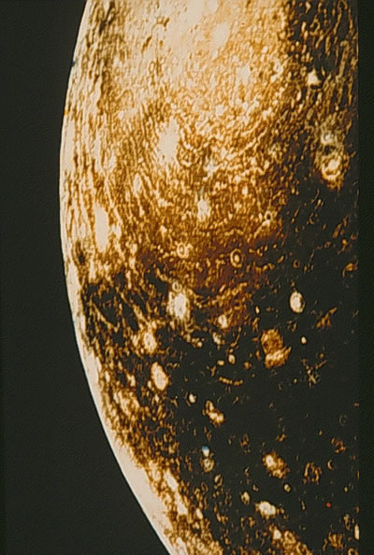
The Moons of Jupiter - Calisto
Callisto, looks similar to the dark regions on the surface of Ganymede.
The surface is covered with numerous impact craters
This indicates little geologic activity since the intense bombardment of the early solar system.

Slide 7
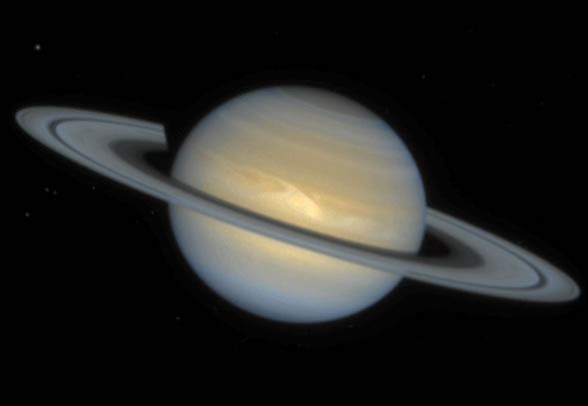
Saturn from HST
The Second largest planet
Lowest density of any planet
Most notable ring system of the outer planets (which all have some rings)
Saturn’s more yellowish color compared to Jupiter is due to more sulfur
A day on Saturn is 10 hrs. and 47 min. long.
A Saturn year is 29.7 Earth years

Slide 8
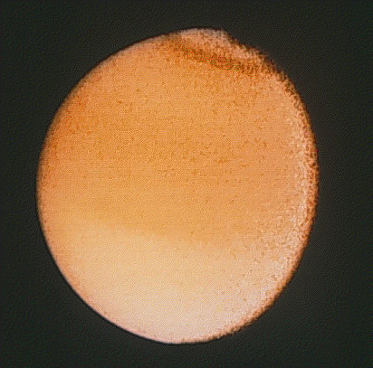
Saturn’s Moons - Titan
The largest moon of Saturn (only slightly smaller than Ganymede)
Titan is the only satellite with a significant atmosphere (Nitrogen and methane)
Voyager 1 images show a dense cover of clouds or haze
Titan’s atmosphere was found to be composed mostly of nitrogen.
Many scientists believe Titan’s atmosphere may be similar to the conditions that existed on Earth, possibly allowing the development of primitive lifeforms

Slide 9
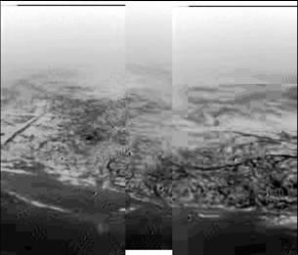
This is the surface of Titan – photo from the
Cassini – Huygens probe

Slide 10
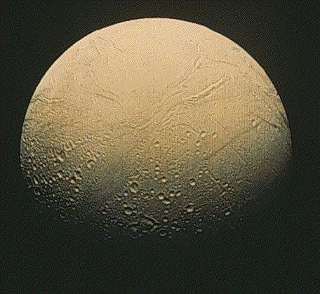
Saturn’s Moons - Enceladus
Enceladus has a very bright surface composed of ice.
The Cassini space probe in 2005 showed water rich plumes erupting from Enceladus
Liquid water leads scientists to believe life could possibly form here

Slide 11
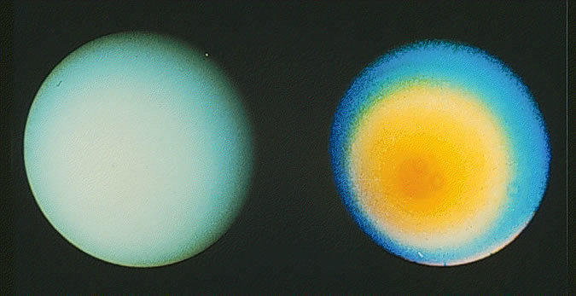
Uranus
Left image is natural color
The atmosphere does not have the banded structure of Jupiter or Saturn
Uranus has a “retrograde rotation” like Venus and Pluto
Uranus rotation is also on its side – its south pole faces the sun
The theory for this odd rotation is the Uranus was hit by a large object sometime in the past

Slide 12
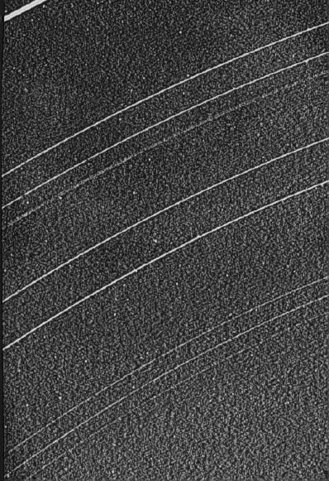
Rings of Uranus
Like all the outer, gas giant planets, Uranus has rings
These are tilted 93 degrees like its rotation

Slide 13
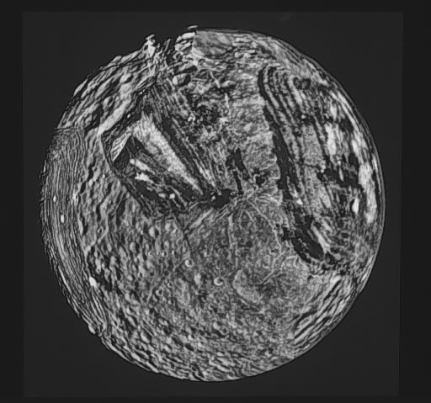
Moons of Uranus - Miranda
Some of the grooves and cuts seen in Miranda’s surface are 20km deep.
Miranda itself is only 290Km in diameter
Uranus moons have a normal rotation

Slide 14
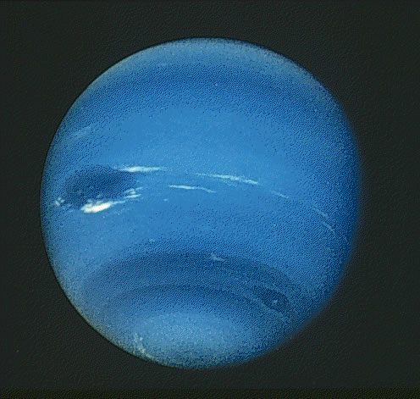
Neptune
The fourth largest planet and furthest from the Sun
Fastest winds in the solar system 2,000 km/hr
13 moons
One Neptunian year = 165 Earth yrs.
Atmosphere of mostly hydrogen and helium
Neptune was discovered “on paper” using Newton’s laws before it was observed.

Slide 15
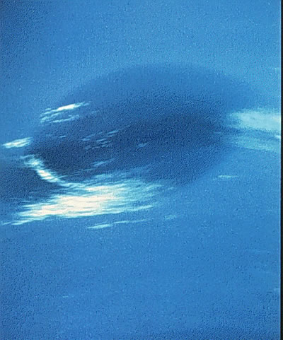
Neptune’s Great Dark Spot
Voyager 2’s image at its closest approach to the planet
Appears to be an Earth-sized rotating storm system
Hubble images in 1995 showed the spot had disappeared

Slide 16
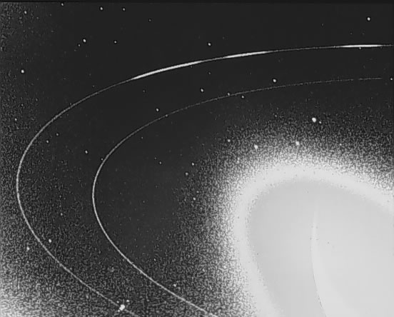
Neptune’s rings
Voyager also confirmed that Neptune has a ring system like the other gas giants

Slide 17
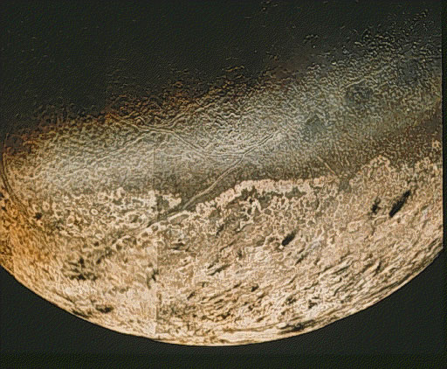
Triton - Neptune’s largest Moon
Slightly smaller than Earth’s Moon
Extremely cold at 37K or - 400º F
The lighter color may be frozen nitrogen in addition to darker methane ice
Triton has the same density and reflectivity as Pluto so it may be a glimpse of what Pluto is like

Slide 18
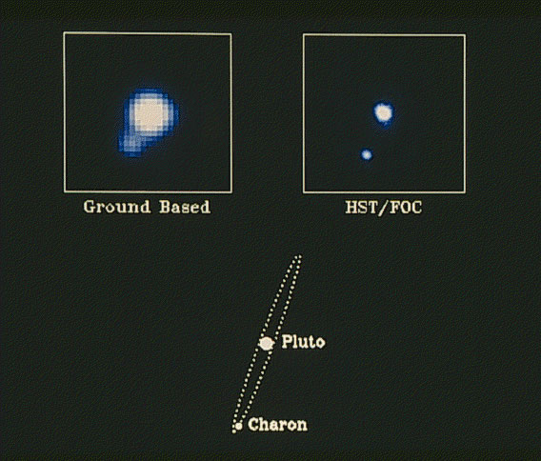
Pluto
Until recently little blurs were the best images of Pluto

Slide 19
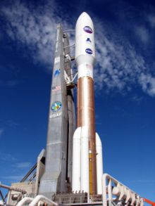
New Horizons Mission to Pluto and the Kuiper Belt
New Horizons left Earth January 19, 2006
Its closest approach to Pluto will be on July 14, 2015

Slide 20
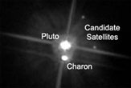
Pluto’s Moons
We have learned that in addition to Charon, Pluto has two smaller Moons
They have been named Nix and Hydra

Slide 21
Is Pluto a Planet?
Yes | No
It has always been considered a planet | Very small Very elliptical orbit Out of plane of ecliptic Same material as Kuiper belt objects Found other “non-planets” that were larger
Image based on NASA images,
from http://en.wikipedia.org/wiki/Image:EightTNOs.png

Slide 22
