Slide 1
Chapter 10
Newton’s 2nd Law of motion

Slide 2
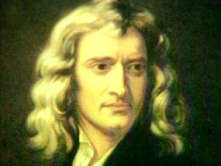
Newton has Three Laws of Motion

Slide 3
Chapter 10
Main Ideas
Details
2nd Law
F=MA
Newton’s Second Law –
FORCE = MASS X ACCELERATION
The GREATER THE MASS of an object, the MORE FORCE it can exert
The GREATER THE ACCELERATION, the MORE FORCE it can exert

Slide 4
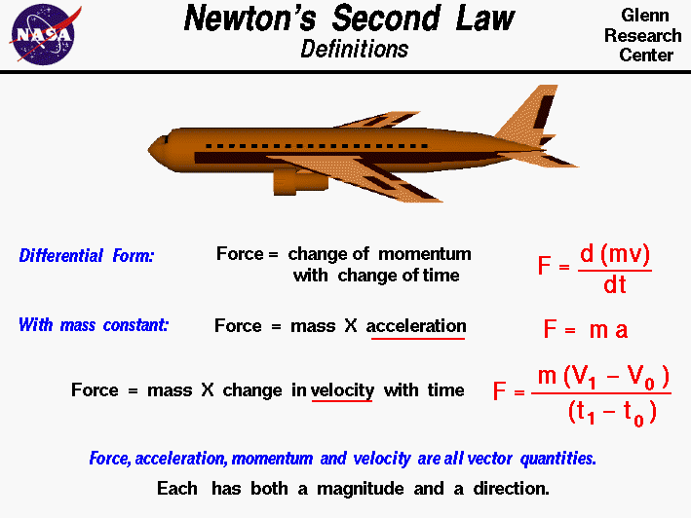

Slide 5
Chapter 10
Main Ideas
Details
2nd Law equation
With this equation we can solve for each variable
FORCE = MASS X ACCELERATION
F
M
A
Mass =
Force/Acceleration
Acceleration =
Force/Mass

Slide 6
Chapter 10
Main Ideas
Details
2nd Law example
Question #1
A speedboat pulls a 55kg water skier at an acceleration of 2.0m/s/s. Calculate the net force that causes this acceleration.
Force= Mass x Acceleration
55kg
X 2m/s/s
_______
110 N

Slide 7
Question # 2
What is the force that is need to pull a 25kg wagon at an acceleration of 14m/s/s?
F=mxa
25kg x 14m/s/s =350N

Slide 8

Question #3
What is the acceleration of a 60kg Boa Constrictor with a force of 120N?
a=f/m
120N / 60kg = 2 m/s/s

Slide 9
Next
Now go to Newton’s 2nd law to solve some word problems.

