Slide 1
CARBON CHEMISTRY

Slide 2

INTRODUCTION VIDEOCLIP

Slide 3
Discuss with a partner…
In the videoclip, they mentioned that CARBON IS A VERSATILE ELEMENT. Discuss with a partner what the word VERSATILE means.
In what ways is carbon a VERSATILE element? Write this down on your notes.

Slide 4
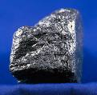
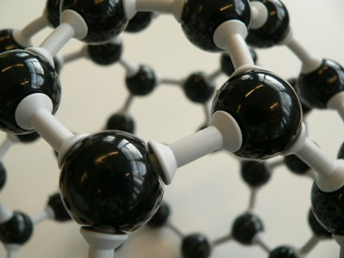
Life is all about… CARBON!!!
- Carbon has 4 valence electrons, so it can form many covalent bonds. **Review: What’s a valence electron?
- It has the unique ability to bond with itself and other elements.
- Thus, MANY compounds are made with carbon.

Slide 5
Page 293 in textbook…
Draw the 4 ways to represent how carbon bonds with other atoms:
Model | Drawing
Cloud Model
Electron Dot Diagram
Ball and Stick Model
Structural Diagram

Slide 6
Pure Carbon
Since carbon is able to bond in so many ways, it can exist in 4 pure forms.

Slide 7
Tree Map of the 4 Different Forms of Pure Carbon
Forms of Pure Carbon
Diamond
Crystalline Form
Graphite
Carbon Atoms arranged in LAYERS
Nanotubes
Fullerene
Dome-Shaped
Cylindrical Shape of Carbon

Slide 8
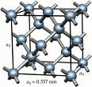
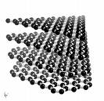
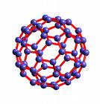
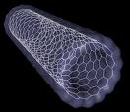
Diagrams
Crystal Structure of
Diamonds
Layers of graphite
Fullerenes
“Geodesic domes”
Nanotubes

Slide 9
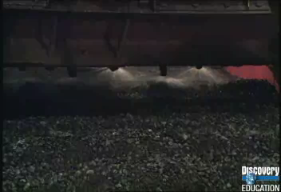
Videoclip: Nanotube Technology

Slide 10
Group Tree-Map
Your group will now create a tree-map based on the 4 forms of carbon. Each of you in the group will:
Choose one of the 4 forms of carbon.
You will read about each in the text and share information about your form of carbon to contribute to the tree map. (Pgs. 294-295)
Create a group tree map. Each of you must be in charge of sharing and writing down 3 facts about your form of carbon.

