Slide 1
Comets, Asteroids, and Meteors

Slide 2
Comets
Comets = are loose collections of ice, dust, and small rocky particles whose orbits are usually very long, narrow ellipse.
Comet’s head= when the comet gets close to the sun the ice turns into a gas.
Comet’s tail= As the comet heats up the gas and dust stream outward forming a tail. The tail can be up to 100 million kilometers long.
Think-pair share : Where do comets come from?

Slide 3

Comet video clip

Slide 4
Asteroids
Asteroids= are rocky objects too small and too numerous to be considered planets.
Most asteroids revolve around the sun in fairly circular orbits between Mars and Jupiter in a region called the Asteroid belt.
One asteroid that hit earth 65 million years ago filled the atmosphere with dust and smoke blocking sunlight around the world. Scientists believe this is how the dinosaurs became extinct.

Slide 5
Meteors
Meteoroid= is a chunk of rock and dust in space that comes from a comet or asteroid.
Meteor = When a meteoroid enters earth atmosphere friction with the air creates heat and produces a streak of light.
Meteorites= Meteoroids that pass through the atmosphere and strike earths surface is called a meteorite.
Think- pair share: Where do Meteoroids come from?

Slide 6
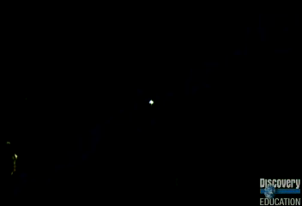
Asteroids and meteors video clip

Slide 7
Earth’s 10 biggest impacts
Impact link

Slide 8
Nova video 2036
Asteroid 2036

