Slide 1
Bottle Rockets
Mrs. Gonzales

Slide 2
How Water Rockets Work
A water rocket works using the same principles as other rockets. There are three main forces in action: thrust (Fapp), drag (Ffr) and weight (w=mg). The water, which is forced out by the difference between internal and atmospheric pressure, is a reaction mass that provides the thrust. All rockets have a reaction mass, which can vary from hot gasses that are expelled when a fuel is burnt (in the Space Shuttle's SRB's for example) to water in a water rocket. The air molecules moving along the side of the rocket as it is moving create friction and result in the drag force (the drag attempts to slow the rocket down and so acts in the opposite direction as the velocity of the rocket). Weight is simply the mass of the rocket multiplied by gravity and applies to all objects within a gravitational field. Again, this force works against the rocket’s thrust, trying to bring the rocket back down to Earth.

Slide 3
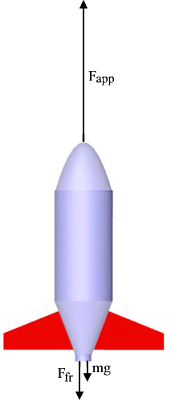
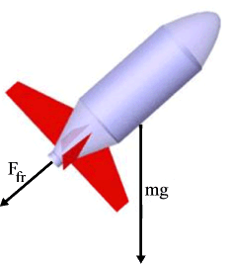
How bottle rockets work

Slide 4
How much water should I add?
A correct balance between the volumes of water and air must be found because the air stores the bulk of the energy inside the rocket. If the water volume is too high compared to the air volume, too little energy will be stored (since, as previously stated, water does not store energy inside the rocket; the air does). On the other hand, if there is too little water the reaction mass will be insufficient to provide much acceleration, since air is far lighter than water and so, again, the performance of the rocket will be less than optimum. Experimentally, a water-to-air ratio of 1:2 (one third of the volume is water) has been found to generally be the most efficient.

Slide 5
Stability
rocket's stability is critical for achieving high altitude flights - an unstable rocket will go up about 50 feet (max.) and then flutter back down to the ground. There are two ways to change the stability - change the surface area of the fins, or add ballast to the nose. Clearly the overall weight of the rocket must also be considered, so increasing the surface area of the fins is usually the preferred method. This however increases drag obviously and so a stabile rocket is generally a compromise between drag and weight.
A rocket, once it is in flight, has eight degrees of freedom; in other words there are eight different directions in which the rocket can move. Two of these are linear - thrust and drag. The other six are rotational and are yaw left, yaw right, pitch up, pitch down, roll right and roll left.

Slide 6
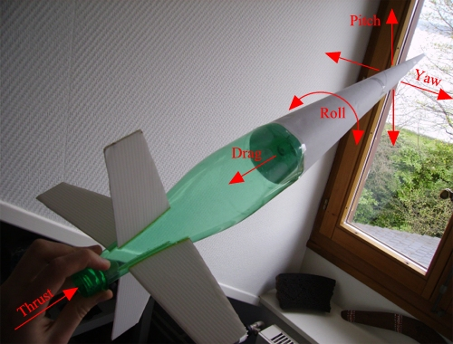
Stability

Slide 7
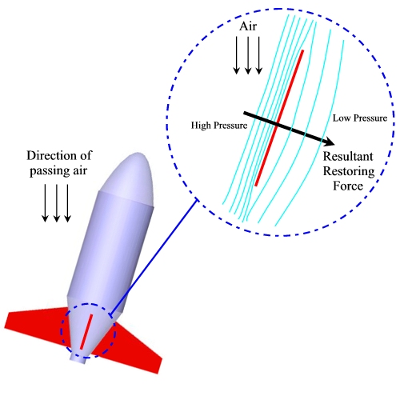
Fins
How fins work is by using air pressure differences to generate a restoring force.
Usually in water rocketry it's safe to have the Center of Pressure ( CP) a minimum of several centimeters (5-10) behind the Center of Gravity (CG).

Slide 8
Fins
When designing your fins you want to think of several things.
1. What size fins do you want. Do you want larger ones for more stability or smaller ones with less drag.
2. Think about the size and weight of your rocket. If it is taller and heavy longer fins would make sense to make it more stable.
3. If your rocket is smaller and weighs less, make smaller fins with that give the rocket little drag. Use a material that will have strength such as a cereal box or manila envelope.

Slide 9
Fin Placement
Placement of the fins is key to having a stable rocket. You want to place them 5-10 cm below the Center of Gravity (CG). I will show you how to find the center of gravity.
Also be sure to place them evenly.

Slide 10
Nose cones
A nose cone and fins are the most critical aerodynamic components of a rocket. A simple paper cone taped on top of the rocket is enough to significantly reduce the rocket's coefficient of friction, however more complex shapes may be used to further improve a rocket's performance (and some are surprisingly easy to make). There are three common shapes used for nose cones: conical, ogive and parabolic, as shown in the diagram on the next slide.

Slide 11
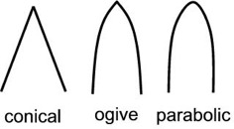
Types of nose cones

Slide 12
Rockets Away simulation
Rocket link

