Slide 1
FORCES

Slide 2
Think About It…
What do you think makes a building stay up?
When you throw a ball, what makes it fall down?
What do you think makes the Earth rotate around the sun?
When a bumper car hits another car, what causes it to go a different direction?

Slide 3
Share Your Answers With A Partner
Share Your Answers with a partner. Both Partners need to speak to one another.

Slide 4

What is a force and how can we describe it?
A FORCE is a PUSH OR PULL WHICH HAS BOTH MAGNITUDE (STRENGTH) AND DIRECTION.
Example:
We use VECTORS (arrows) to show the magnitude and direction of a force.
The unit for force is NEWTONS (N), which shows how strong the force is. *One pound force= 4.4 N
25 N

Slide 5
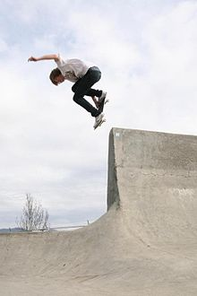
Examine this force:
Describe the force of this skateboarder to your partner. You must use the terms magnitude and direction
500 N

Slide 6
Balanced vs. Unbalanced Forces
If two forces on an object, are equal and BALANCED, there will be NO CHANGE in its velocity. (speed up, slow down, or change direction)
If two forces on an object are UNBALANCED, this will result in a CHANGE in its velocity.
Pg. 376-377

Slide 7
Example #1
Arnold Schwarzenegger is moving out of his California mansion. He pushes a box of books on the floor with a force of 50 N to the right. The frictional force of the floor opposes his push with a force of 30 N.
  Draw in the forces, using vectors (arrows)
  Are the forces balanced or unbalanced? _____________
  Will the box accelerate? __________ If so, in which direction? __________

Slide 8
Solving example #1:
  Draw the forces.
  Are the forces balanced or unbalanced? UNBALANCED
  Will the box accelerate? __YES__ If so, in which direction? __RIGHT____
50 N
30 N

Slide 9
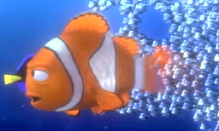
Example #2: Work with a Partner
Nemo is trying to swim up stream to be found… again. He pushes forward with a force of 2 N. The stream pushes back on him with a force of 2 N.
  Draw in the forces using vectors (arrows).
  Are the forces balanced or unbalanced? ____________
  Will he accelerate? ______________ If so, in which direction? __________

Slide 10

Solution to Problem #2:
  Draw in the forces using vectors (arrows).
  Are the forces balanced or unbalanced? __BALANCED___
  Will he accelerate? ___NO______ If so, in which direction? __WILL NOT CHANGE___
2N
2N

Slide 11
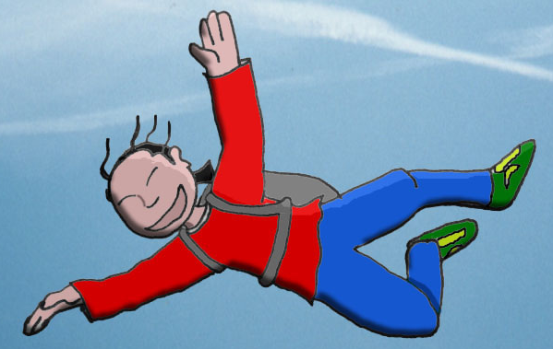
Example #3: Do on your own…
James Bond has a weight of 1700 N. He skydives out of a plane to evade the nuclear bombs heading for his airplane. The air resistance pushes back on him with a force of 700 N.
  Draw in the forces using vectors.
  Is there a net force on James? ­_____ If so, label it on your diagram.
  Will he accelerate? ______________ If so, in which direction? __________

Slide 12
Summary
A force has BOTH magnitude and direction.
Forces can cause objects to accelerate or change in velocity.
A NET FORCE is the overall effect of 2 or more forces acting on an object.
BALANCED forces DO NOT change an object’s velocity.
UNBALANCED forces WILL change an object’s velocity.

Slide 13
Brainpop
http://www.brainpop.com/science/motionsforcesandtime/force/

