Slide 1

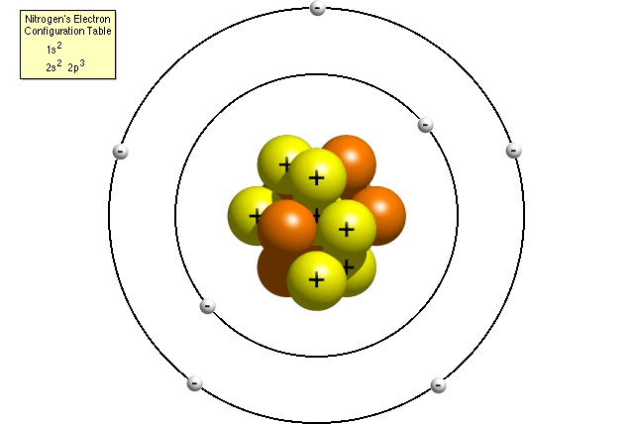
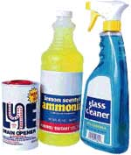

Acids, Bases, and Solutions

Slide 2
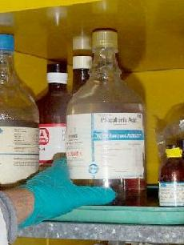
Describing Acids and Bases
Main Ideas
Details
Properties
Of Acids
An acid
  tastes sour
  reacts with metals
  turns litmus red
“Corrosive” – An acid acting on a metal to
Eat it away

Slide 3
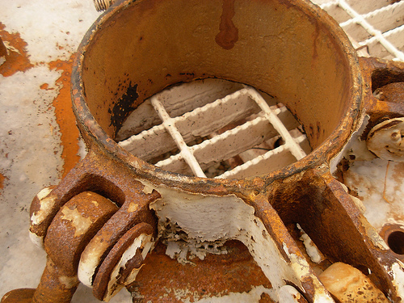
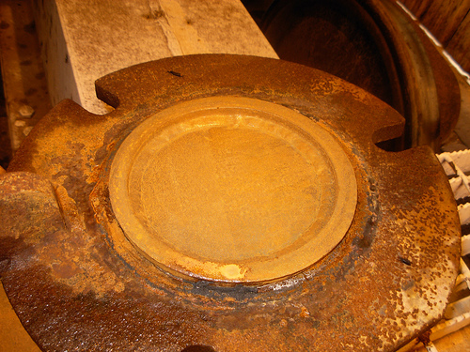
Corrosion of steel tank car by sulfuric acid

Slide 4
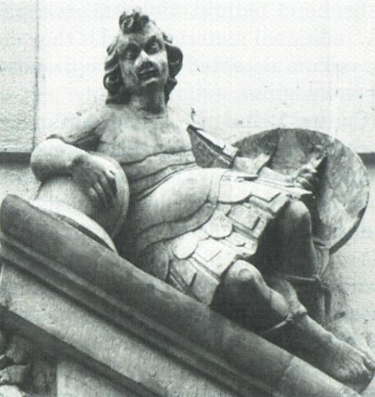
Affects of Acid Rain
Statue 1906 before significant acid rain

Slide 5
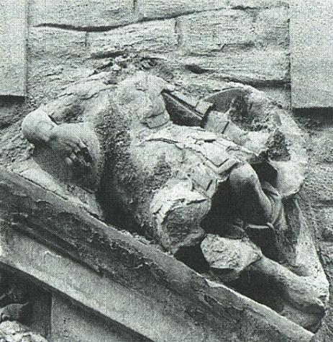
Affects of Acid Rain
Same Statue 1986

Slide 6


Slide 7
Chapter 19. 2 Describing Acids and Bases
Main Ideas
Details
Properties
Of Bases
A Base
  tastes bitter
  feels slippery
  turns litmus blue
An “indicator” is a substance that turns
different colors in acids and bases

Slide 8


Slide 9
Properties of Acids Bases in Solutions
Main Ideas
Details
Atoms in
Acids & Bases
An Acid forms H⁺ ions in solution with water
HCl (in H₂0) -> H⁺ + CL⁻
A Base forms OH⁻ ions (hydroxide) in solution with water
NaOH (in H₂0) -> Na⁺ + OH ⁻

Slide 10


Slide 11
Properties of Acids Bases in Solutions
Main Ideas
Details
pH Scale
The pH scale measures the acidity of a solution
pH < 7 is acidic
pH > 7 is basic
pH = 7 is neutral (pure water)
If an acid reacts with a base it will form water and a salt

Slide 12
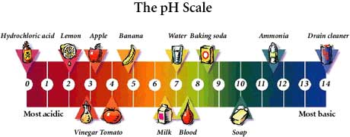

Slide 13
[H⁺] | pH | Example
Acids | 1 X 10⁰ | 0 | HCl
 | 1 x 10⁻¹ | 1 | Stomach acid
 | 1 x 10⁻² | 2 | Lemon juice
 | 1 x 10⁻³ | 3 | Vinegar
 | 1 x 10⁻⁴ | 4 | Soda
 | 1 x 10⁻⁵ | 5 | Rainwater
 | 1 x 10⁻⁶ | 6 | Milk
Neutral | 1 x 10⁻⁷ | 7 | Pure water
Bases | 1 x 10⁻⁸ | 8 | Egg whites
 | 1 x 10⁻⁹ | 9 | Baking soda
 | 1 x 10⁻¹⁰ | 10 | Tums® antacid
 | 1 x 10⁻¹¹ | 11 | Ammonia
 | 1 x 10⁻¹² | 12 | Mineral lime - Ca(OH)₂
 | 1 x 10⁻¹³ | 13 | Drano®
 | 1 x 10⁻¹⁴ | 14 | NaOH

Slide 14


Slide 15
Digestion and pH

Slide 16
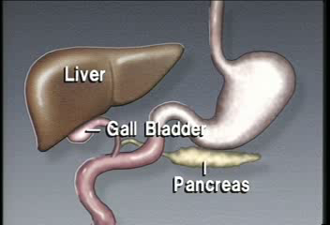

Slide 17
Digestion & pH
Main Ideas
Details
Digestion
Digestion breaks down complex food
Molecules for use by the body
These products are used for
  Energy (cellular respiration)
  Raw material for the body
Mechanical Digestion – rips, crushes, grinds and mashes food particles
Mechanical & chemical digestion
Chemical Digestion – breaks large molecules down to simpler products

Slide 18
Digestion & pH
Main Ideas
Details
Enzymes aid chemical digestion
Chemical digestion takes place with the help of “enzymes”
Enzymes are “catalysts” – molecules that speed reactions
Different enzymes need different pH to operate effectively
  Amylase in the saliva breaks down carbohydrate (sugars) @ pH 7
  The stomach’s pH is around 2.0 for digestion of protein using the enzyme “pepsin

Slide 19
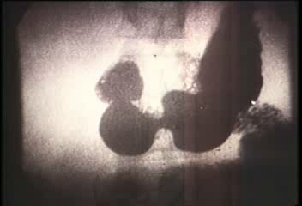

Slide 20
Digestion & pH
Main Ideas
Details
Chemical digestion & absorption
Proteins are broken down to “amino acids”
In the small intestine fluids contain the base HCO₃⁻ which creates a basic pH of 8
Digestion is completed in the small intestine and absorption of the products into the blood stream begins

Slide 21
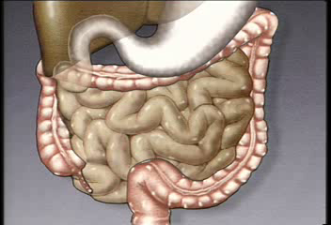

Slide 22
Acids, Bases and pH
Main Ideas
Details
Summary
Write a short one paragraph summary of the material in these notes.

